Slide 1
Educational Video Game for Learning English Vocabulary in China Classroom Context
Supervisors: John Woodward & Atm Alam
Independent Assessor: Paulo Rauber
Name: Jianshu Qiao
Date: 15.Feb 2023

Slide 2
Overview
1
2
3
Word Maker
Two Problems
My solution

Slide 3
Part One
Word Maker

Slide 4
Word Maker
I will demonstrate the current version of Word Maker. There are a few improvements since you have seen last time.
1: Students can click letters to achieve spelling, which saves much time.
2: Students can click to hear pronunciation.
3: Students can click to check spelling.
4: I finish the score rules.
(1): In the first three levels, they can collect 1 point for each correct spelling.
(2): In the hardest level, they can collect 2 point for each correct spelling.
(3): They can collect 1 point for hearing pronunciation more than 3 times for each task. (Encourage practice listening)

Slide 5
Experiment
I will conduct one experiment in March.
Purpose:
(1): Which operation method (Mouse/Keyboard) do students frequently use?
Solution: I will count the number of mouse and keyboards, and decide which operation we use.
(2) 5 volunteer insisted that drawing letter is inconvenient. Therefore, I changed it to click.
(3) Compare the Word Maker and Rote memory in spelling and recognition.
participants: 20
unknown words: 10
post-test: 10 minutes, 2 days
Analysis: Accuracy: Binary Method; Completeness: Levenshtein distance.
Hypothesis: Word Maker is better (at least same) than rote memory in spelling and recognition.
(4) Collect date for training Reinforcement Learning.
(5) Conduct a questionnaire：
Whether Word Maker can keep lasting motivation and concentration than Rote Memeory.
How to improve Word Maker?
How to make Word Maker more fun?

Slide 6
Part Two
Two Problems

Slide 7
Current Problems
Problems One: Enjoyment: Enjoyment is important to (1) keep lasting motivation and concentration, e.g., 30 minutes; (2) autonomous learning, e.g., 30 minutes a day, three times a week
My problems: How to achieve the two objectives? (badge, score?)
Problems Two: Dynamic Difficulty Adjustment
Student_1: Cat, Big, Horse, Elephant. The learning speed of each word is different.
 | Loop_1 | Loop_2 | Loop_3 | Loop_4
Cat | d₁ | d₄
Elephant | d₁ | d₂ | d₃ | d₄
Student_1 and Student_2 : Cat, Big, Horse, Elephant. The difficulty of same word is different for each student.
 | Loop_1 | Loop_2 | Loop_3 | Loop_4
Elephant | d₁ | d₂ | d₃ | d₄
Elephant | d₁ | d₂ | d₄

Slide 8
Expected Learning Process
Task Pool
Cat: current deck
Dog: current deck
Fish: 0-2-5-9 file
Bee: 1-3-6-0 file
Crab: 5-7-0-4 file
Cut: 8-0-3-7 file
Present Tasks
Cat
Dog
Fish
Bee
Crab
Cut
Test_1
Cat: d_1
Dog: d_1
Fish: d_1
Bee: d_1
Crab: d_1
Cut: d_1
Study_1
Cat: cgt
Dog: dog
Fish: fesh
Bee: bee
Crab: creb
Cut: cvt
Test_2
Cat: d_2
Dog: d_3
Fish: d_4
Bee: d_4
Crab: d_1
Cut: d_2
Study_2
Cat: cet
Dog: dog
Fish: Fish
Bee: Bee
Crab: creb
Cut: cit
Advantages:
(1): save time
(2): balance students’ English proficiency and learning speed
(3) Feel boring or frustrated
(4) Keep Effectiveness
Study_4
Cat: cgt
Dog: dog
Fish: Fish
Bee: Bee
Crab: creb
Cut: cvt
Test_4
Cat: d_4
Dog: d_4
Crab: d_4
Cut: d_4
Study_3
Cat: cgt
Dog: dog
Fish: Fish
Bee: Bee
Crab: creb
Cut: cvt
Test_3
Cat: d_2
Dog: d_3
Crab: d_3
Cut: d_4

Slide 9
Part Three
My solution

Slide 10
Player Features
All Player Features
Word | Word Length | Attempts | Time consumed | Difficulty level | The number of yellow | The number of red | The number of green
Selected Player Features
Attempts | Time consumed | Difficulty level
 | D_1 | D_2 | D_3 | D_4
Attempts | 0-3 | 0-2 | 0 and 1 | 0 and 1
Time consumed (Seconds) | 0-60 | 0-40 | 0-30 | 0-30
Difficulty level | 1 | 2 | 3 | 4
Possibilities (State Space) | 182 | 81 | 31 | 31

Slide 11
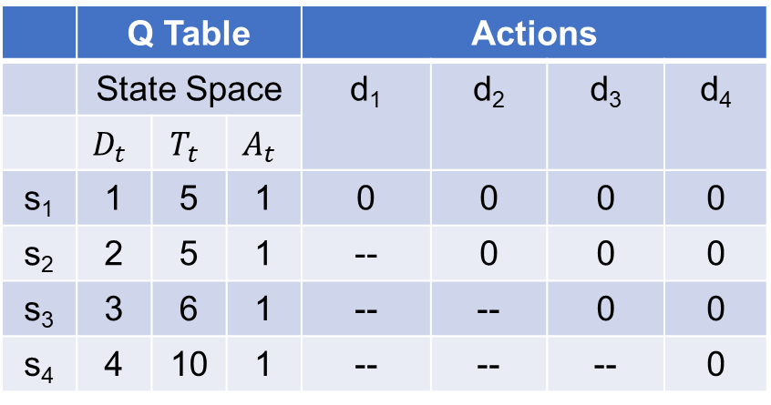
Reinforcement Learning
 | Q Table |  |  | Actions
 | State Space |  |  | d₁ | d₂ | d₃ | d₄
 | $$D_{t}$$ | $$T_{t}$$ | $$A_{t}$$
s₁ | 1 | 5 | 1 | 0 | 0 | 0 | 0
s₂ | 2 | 5 | 1 | -- | 0 | 0 | 0
s₃ | 3 | 6 | 1 | -- | -- | 0 | 0
s₄ | 4 | 10 | 1 | -- | -- | -- | 0
State
(1, 5, 1)
Action
D₂
D₁ (Environment)
Cat
Agent
D₂ (Environment)
Cat
Result
Correct
States
(2, 5, 1)
Result
Correct
State
(4, 10, 1)
Action
D₄
Agent
(Q table)
D₄ (Environment)
Cat
Agent
(Q table)
Result
Correct
Objectives: (1) make sure the accuracy of each step. (5) difficulty does not decrease. Either (2) reach the d₄ as soon as possible (find the shortest episode). Keep or upgrade
(3) the maximum number of step is 4.
(4) the difficulty of level at step₁ is always D₁, and the step₄ is d₄.
Rewards : cat: d₁ (correct), d₂ (correct), d4 (correct) , increase Q (s₁,d₂) ,Q (s₂,d₄), Q (s₁,d₄);
cat: d₁ (correct), d₂ (correct), d4 (wrong) , increase Q (s₁,d₂) , decrease Q (s₂,d₄), Q (s₁,d₄);
Problem: The frequency of each state differ. Therefore, I plan to collect data from players for training the model.
Questions: Can we create a virtual player to simulate students’ learning process?

Slide 12
Backup Solution
I will create ‘Skip’ Button. Therefore, students can choose which level to skip. However, To keep effectiveness
they cannot skip level 1 and level 4.

Slide 13
Future Experiments
(1): Compare Word Maker (Current) with Word Maker (‘Skip’ Button) （In May）.
(2): Compare Word Maker (‘Skip’ Button) with Word Maker (Reinforcement Learning). (In September)
(3): Select the best one (with ‘fun’) to compare with rote memory (In November).
Potential Papers:
(1): The design of Word Maker (EVGs). (In March)
(2):Dynamic difficulty adjustment with Reinforcement Learning in EVGs. (In September)
(3):The EVGs considering classroom barrier, learning theories, game characteristic and in classroom setting
(In November).
Thesis: A research framework in terms of students’ real situation, the design of EVGs, Methodology, Analysis,
Effectiveness. (From February.2024-July.2024, expected DDL. December.2024)

Slide 14
Thanks for your time

